Slide 1
Production Planning for Hot Rolling Systems
Team3 Members:08022310阚宏升
08022311陈鲲龙
08022406陈悦澈
08022405邓卓霖
Date: December 31, 2024

Slide 2
01
02
Modeling
03
02
Algorithms
03
03
Q&A Session

Slide 3
01
Modeling
lecturer:08022311陈鲲龙

Slide 4
Modeling - Background
Products（Sizes, Materials, and Production Lines）
Demand Quantity and Deadlines
eXact Production Schedule
(Production Scheduling for Each Shift)

Slide 5
Modeling - Background - Products
5 Sizes : [ 5.5, 8, 10, 13.5, 14 ]
3 Materials : [ 1, 2, 3 ]
S
where a “ ” indicates that we are required to produce this type of product,
whereas “ ” means we are not.
M

Slide 6
Modeling - Background - Products
5 Sizes : [ 5.5, 8, 10, 13.5, 14 ]
3 Materials : [ 1, 2, 3 ]
S
5 Production Lines : [ 1, 2, 3, 4, 5 ]
L
M

Slide 7
Modeling - Background - eXact Production Schedule
eXact Production Schedule for 12 Shift)
S
S
S
…
…
L
L
L
M
M
M
X(s,m,l,1)
X(s,m,l,t)
X(s,m,l,12)

Slide 8
Modeling - Background - Demand Quantity and Deadlines
Demand Quantity and 2 Deadlines
The required production quantity
← for the 10th
and
12th shifts →
500
800
600
S
S
650
1200
1200
L
450
750
L
M
M
D(s,m,l,10)
D(s,m,l,12)

Slide 9
Modeling - Objective Function & 2 Constraints
Objective
Function
2 Constraints

Slide 10
Modeling - Objective Function - 2 Costs
Holding Costs and Overtime Penalties
The holding costs and overtime penalties for products of each size and material are manually set based on a certain quantity per shift.
S
M

Slide 11
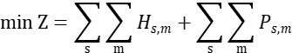
Modeling - Objective Function - 2 Costs
Holding Costs and Overtime Penalties
The holding cost for a product is calculated by accumulating the difference between the production quantity of each shift and the deadline. If the production quantity does not meet the requirement by the deadline shift, an overtime penalty is incurred. These two costs are calculated for each product of all sizes and materials, and their total is summed up. Minimizing this total cost and penalty is our optimization objective.

Slide 12
Modeling - 2 Constraints
Capacity Limits of Each Production Line
At any shift, the Exact Production Schedule cannot allocate a production quantity on any production line that exceeds its capacity limit for a specific product's specification and material.
≤
S
X(s,m,l,t)
C(s,m,l)
S
L
L
M
M

Slide 13
Modeling - 2 Constraints
Production lines cannot produce
products of different sizes
simultaneously.
×
S
×
That is, the exact production schedule
matrix X(s,m,l,t) for each shift
should have only one non-zero row.
×
×
×
×
L
M
X(s,m,l,t)

Slide 14
02
Algorithms
lecturer:08022405邓卓霖

Slide 15
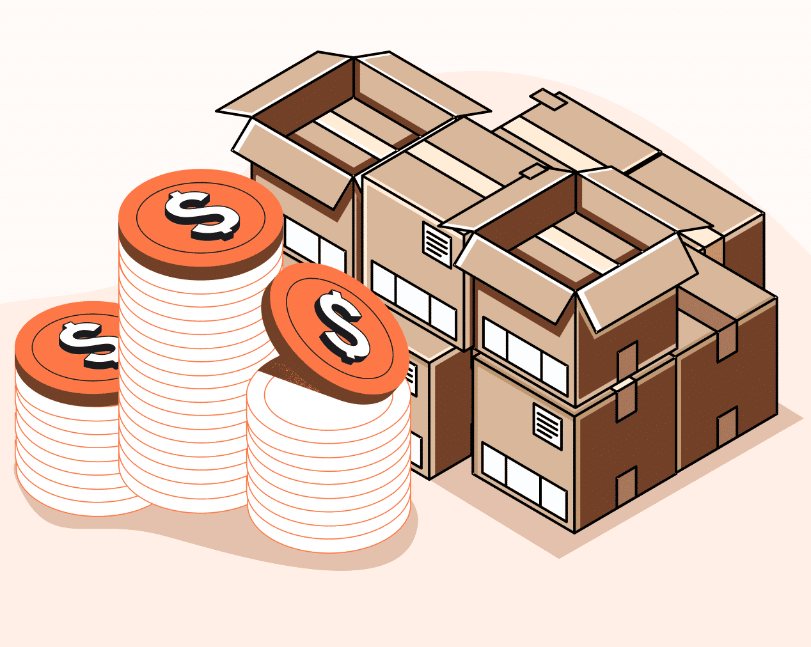
Algorithms-Transform
(1) Storage Cost

Slide 16

Algorithms-Transform
(2) Penalty Cost

Slide 17
Algorithms-Transform

Slide 18
Algorithms-Method
Linearization Method:
Linearizing a nonlinear problem
Interior Point Method:
Finding the optimal solution to a linear problem

Slide 19
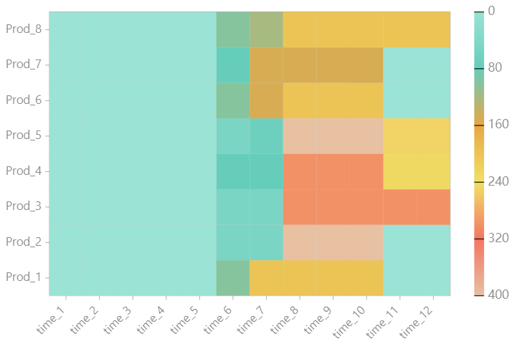
Algorithms-Results
Penalty Cost >Storage Cost

Slide 20
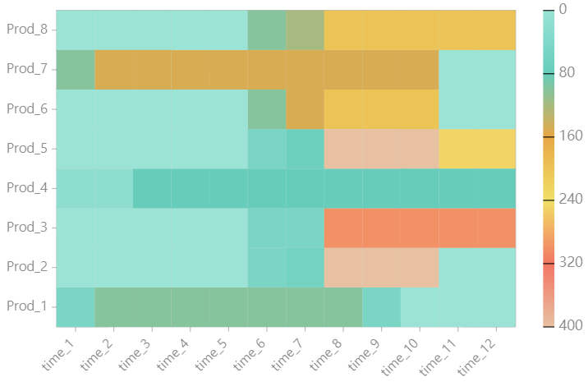
Algorithms-Results
Penalty Cost >>Storage Cost

Slide 21
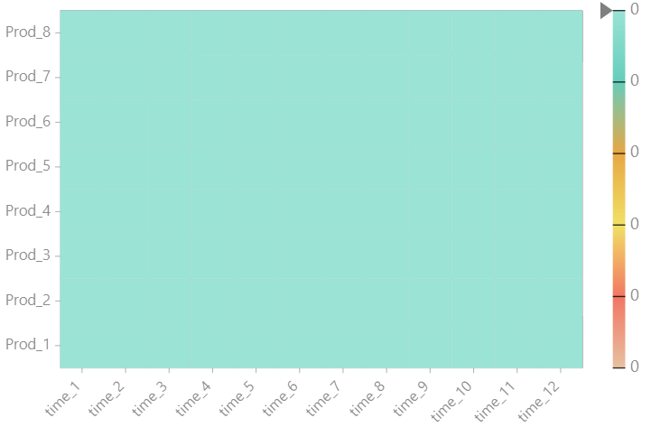
Algorithms-Results
Storage Cost>> Penalty Cost

Slide 22
Algorithms-Results Analyze
Penalty>>Storage
Stable Mode
Penalty>Storage
Explosive Mode
Penalty<<Storage
‘Strike’ Mode

Slide 23
03
Q&A Session

Slide 24
THANKS
Thanks For Your Attention

